Slide 1
Defeating EDRs using D/Invoke

Slide 2


# Whoami
Jean-François Maes
Innovating the Red Team solution since 2020
Creator of redteamer.tips
Host of the voices of infosec podcast
Contributor to SANS SEC560 and SEC699
SEC699: Purple team tactics Instructor
Devourer of chicken and other proteins
#RedTeamFit

Slide 3
Our Agenda
1
A trip down memory lane
5
Messing with creation flags
2
Win32API Primer
6
D/Invoke primer
3
EDRs are malware!?
7
Manual mapping
4
Creating our own EDR
8
Syscalls for the win!

Slide 4

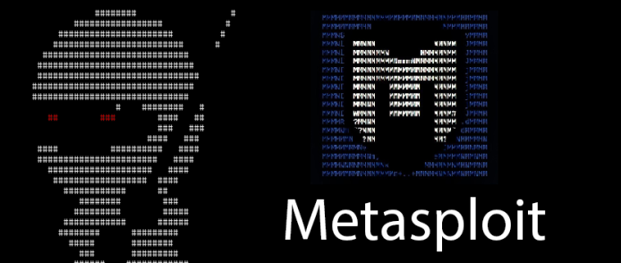
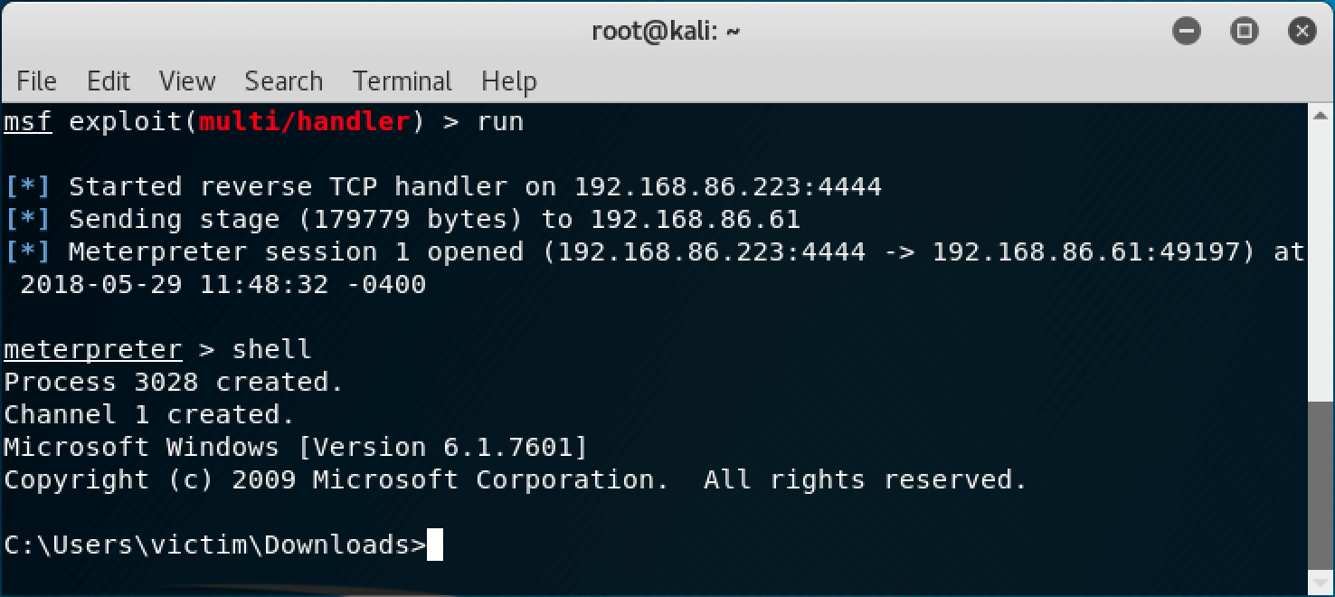
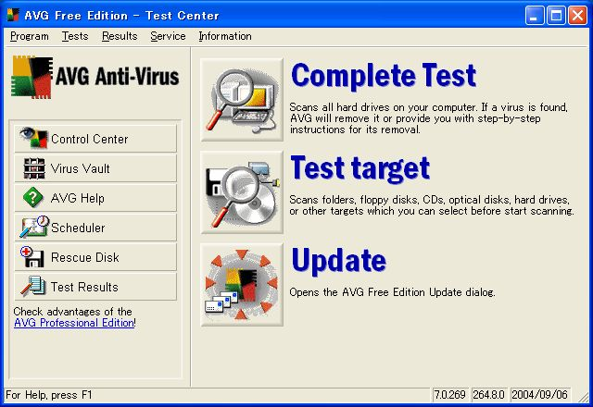
Let's take a trip down memory lane…
Pentesting then vs pentesting now

Slide 5
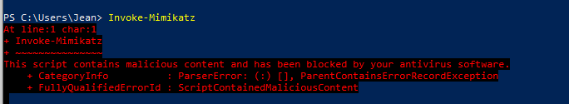

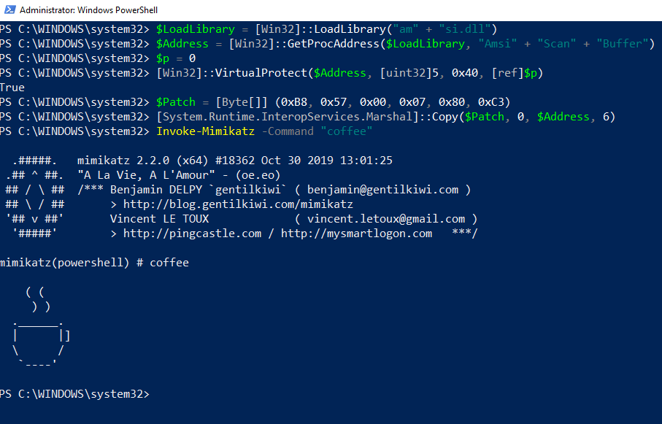
Let's take a trip down memory lane…
Pentesting then vs pentesting now

Slide 6
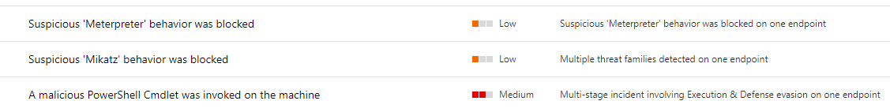




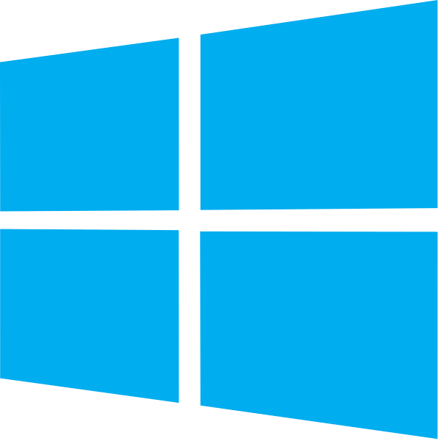
Let's take a trip down memory lane…
Pentesting then vs pentesting now
AppLocker
ExploitGuard
Attack Surface Reduction

Slide 7
WIN32 API
Application
The Windows operating system exposes APIs in order for applications
to interact with the system.
The Windows API also forms a bridge from “user land” to “kernel land”
with the famous ntdll.dll as the lowest level reachable from userland.
Win32 API
Native API (ntdll.dll)
SYS
CALL
User mode
Kernel mode

Slide 8
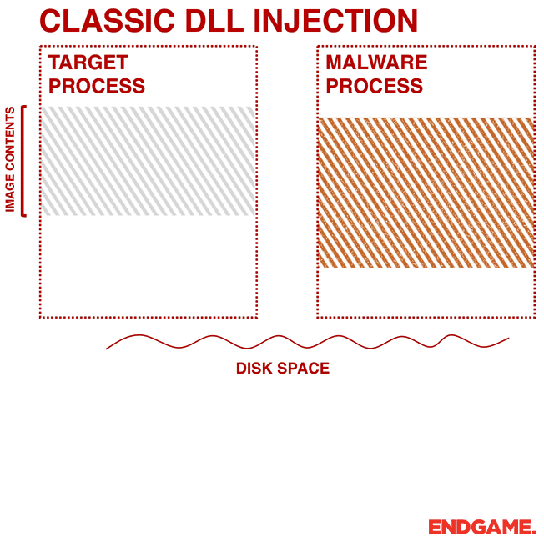
WIN32 API
Naughty stuff you can do with win32
When malicious applications want to interact with the system they will, like other applications, rely on the APIs exposed. Some of the more interesting APIs include:
VirtualAlloc: Used to allocate memory
VirtualProtect: Change memory permissions
WriteProcessMemory: Write data to an area of memory
CreateRemoteThread: Create a thread in the address space of another process

Slide 9

WIN32 API
Naughty stuff you can do with win32
As a rule of thumb (this counts for both defence as offensive tooling), you want to stick as close to kernel mode as possible. As higher tiered WIN32 API calls will always bubble down to ntdll. We can see this using tools such as API Monitor.
Nice read from RastaMouse:
https://offensivedefence.co.uk/posts/dinvoke-syscalls/

Slide 10
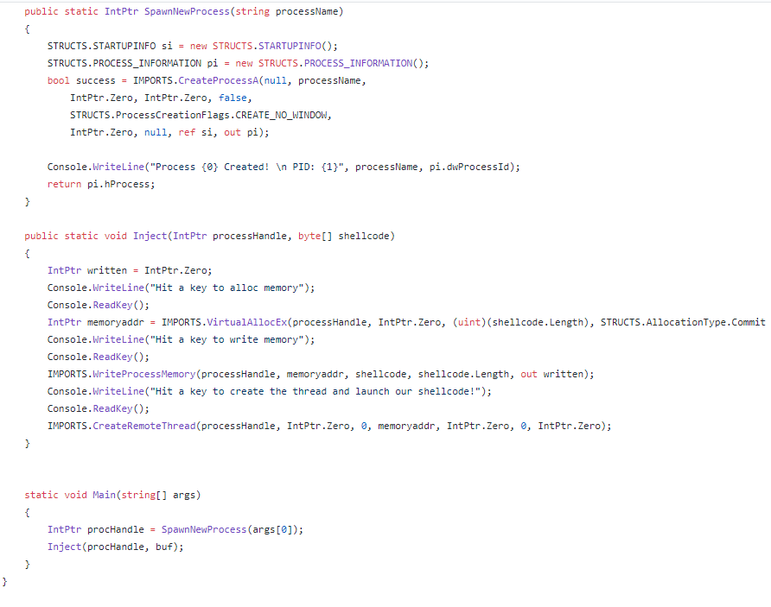
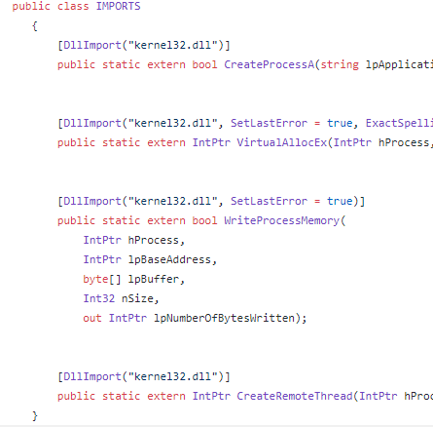
WIN32 – Example loader
Meet our 1337 loader

Slide 11
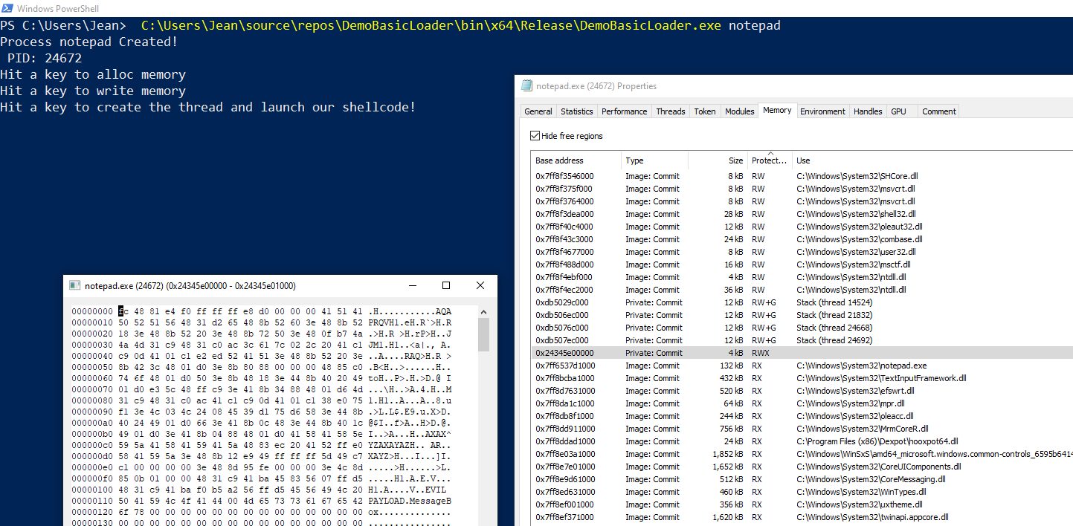
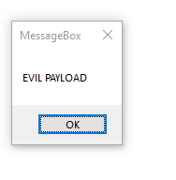
WIN32 – Example loader

Slide 12
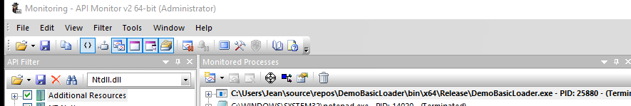
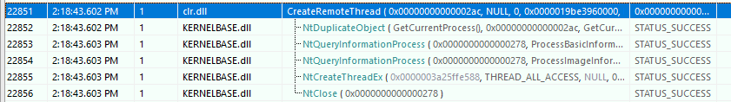
API Monitoring to see if kernel32 does indeed call ntdll

Slide 13
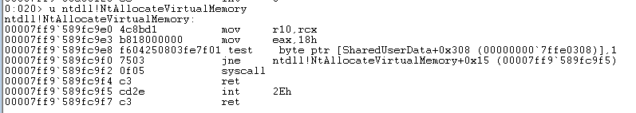
What is so special about NTDLL?
The bridge from user to kernelland
Nt functions are essentially syscall wrappers and will always have the same “skeleton” assembly
Start of Nt signature
Syscall and RET
syscall number pushed to EAX

Slide 14
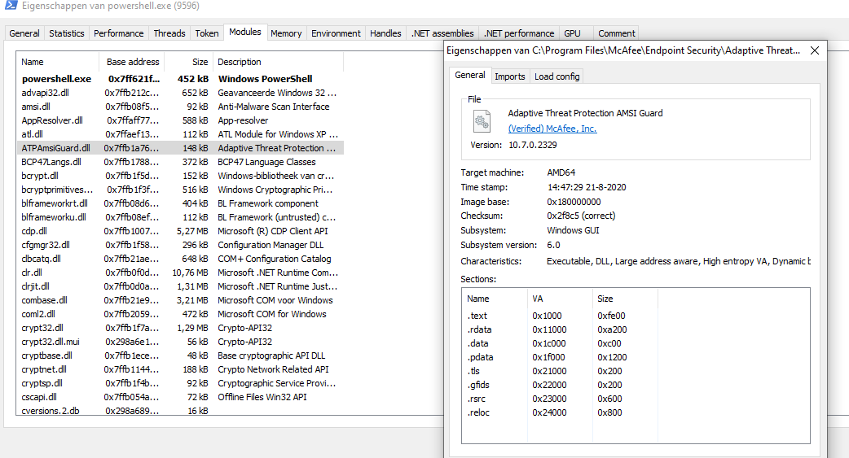
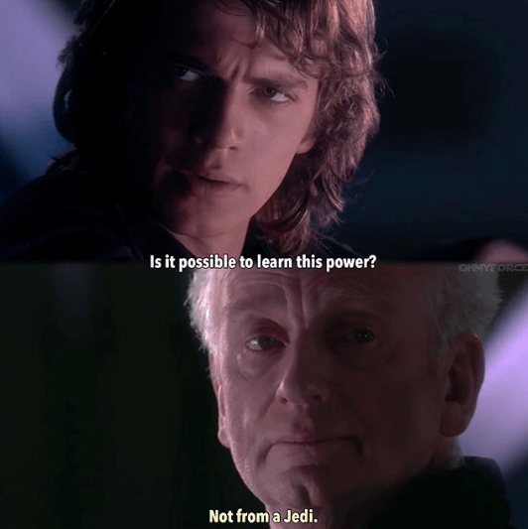
EDRs are malware!?
Did I lose my mind with that statement?

Slide 15
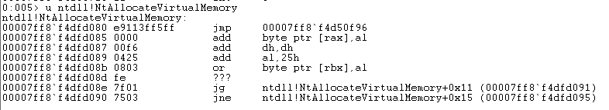
How (most) EDRs work – Userland Hooks
Example of the regular (unhooked) function prototype of NtAllocateVirtualMemory call located in ntdll.dll
Example of the hooked function prototype of NtAllocateVirtualMemory call located in ntdll.dll

Slide 16

TRIVIA:
What happens if you create a loader that calls ntdll.dll when your EDR hooks kernel32.dll?

Slide 17
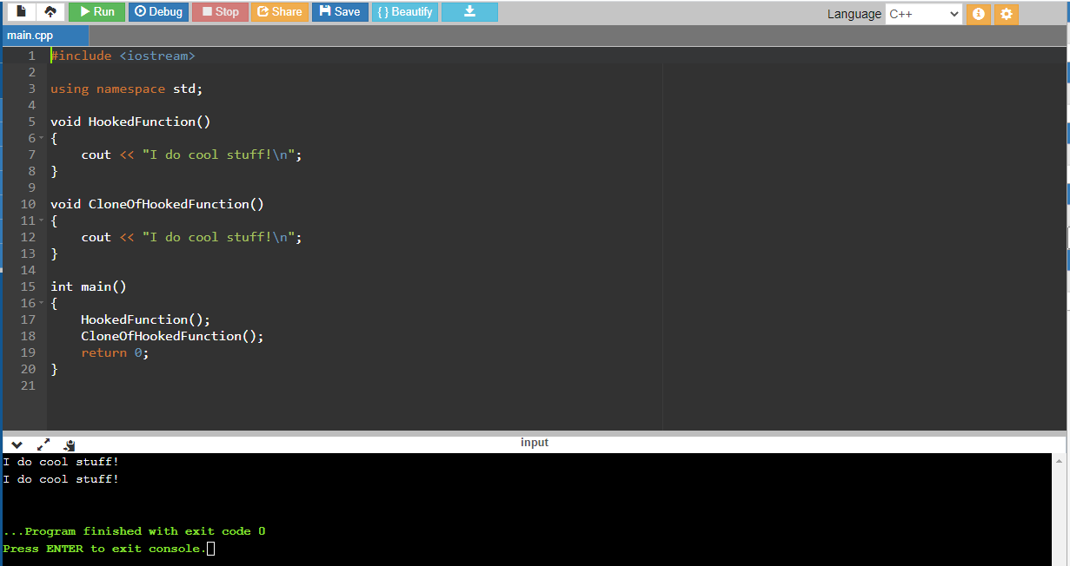
To make it even more obvious

Slide 18
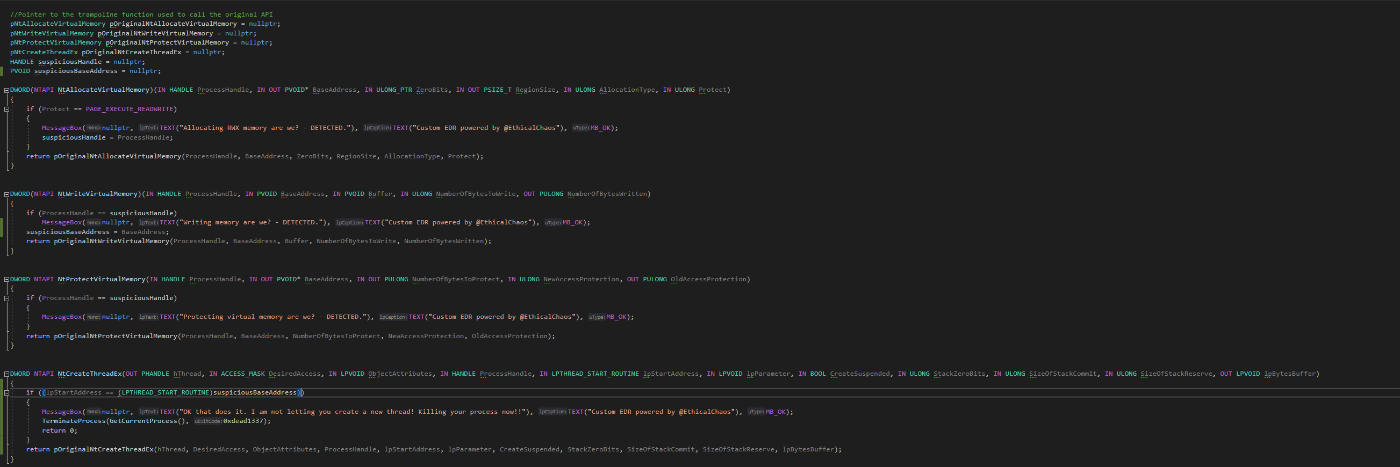
Creating our own EDR
Thanks to Ethical Chaos - SylantStrike

Slide 19
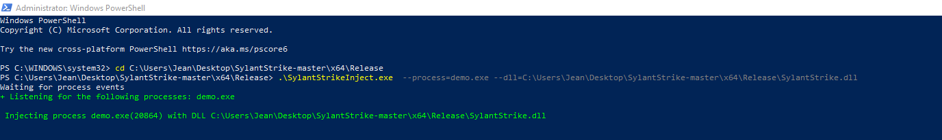
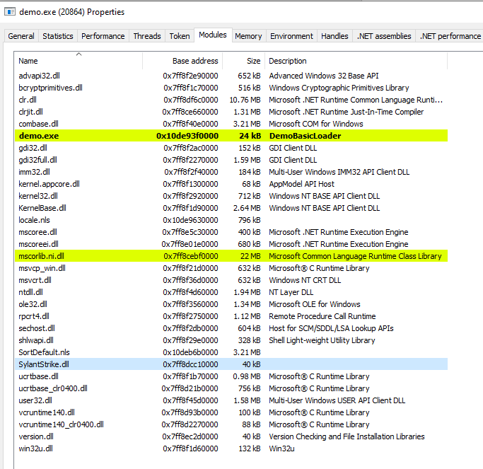
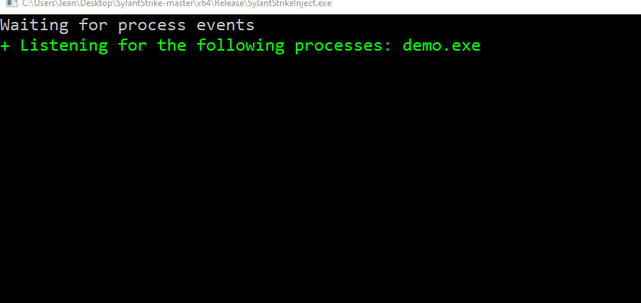
Battle testing our EDR

Slide 20
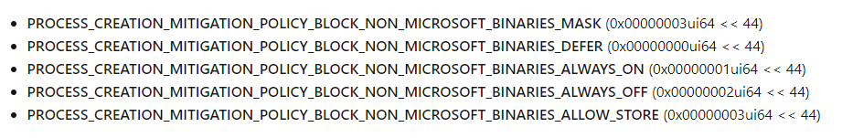
“Quick” Win! Messing with creation flags!
PROC_THREAD_ATTRIBUTE_PARENT_PROCESS | The lpValue parameter is a pointer to a handle to a process to use instead of the calling process as the parent for the process being created. The process to use must have the PROCESS_CREATE_PROCESS access right.Attributes inherited from the specified process include handles, the device map, processor affinity, priority, quotas, the process token, and job object. (Note that some attributes such as the debug port will come from the creating process, not the process specified by this handle.)
Source: https://docs.microsoft.com/en-us/windows/win32/api/processthreadsapi/nf-processthreadsapi-updateprocthreadattribute

Slide 21
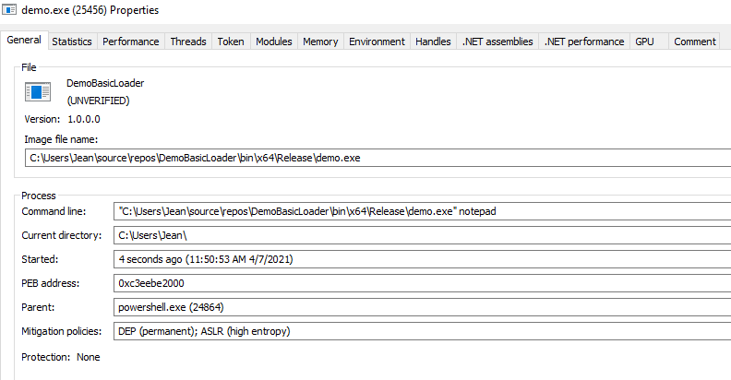
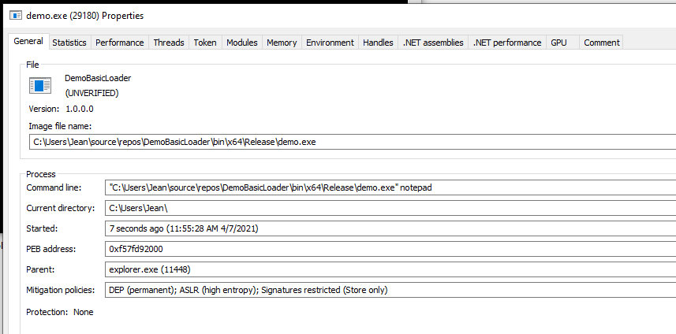
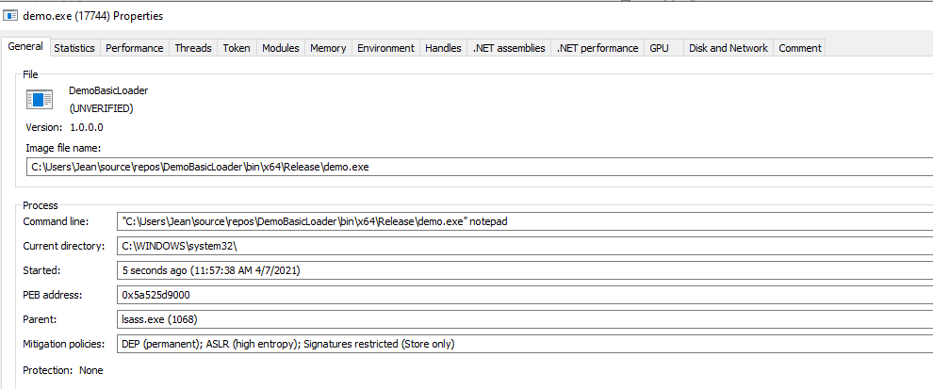
Demoloader with and without creation flag shenanigans

Slide 22
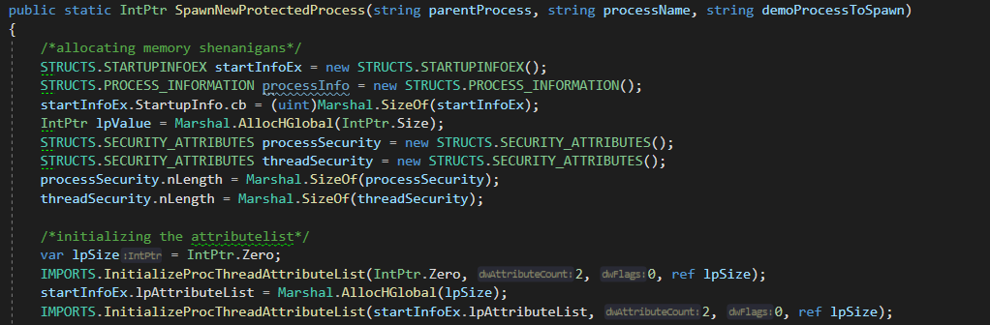
Creating a program to protect our Demo from our EDR
Doing some managed to unmanaged memory gymnastics

Slide 23
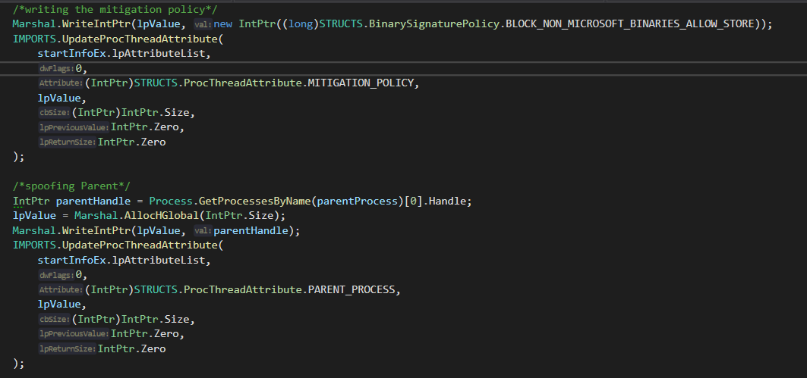
Creating a program to protect our Demo from our EDR
Writing the magic attributes

Slide 24
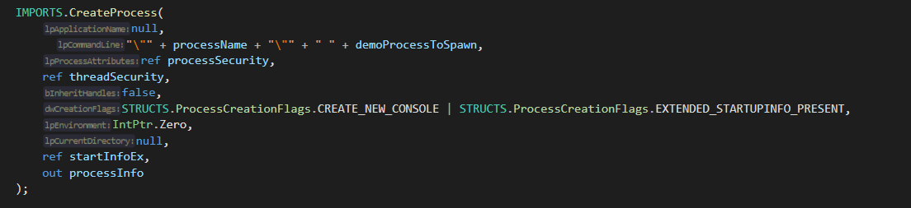
Creating a program to protect our Demo from our EDR
Creating the process

Slide 25
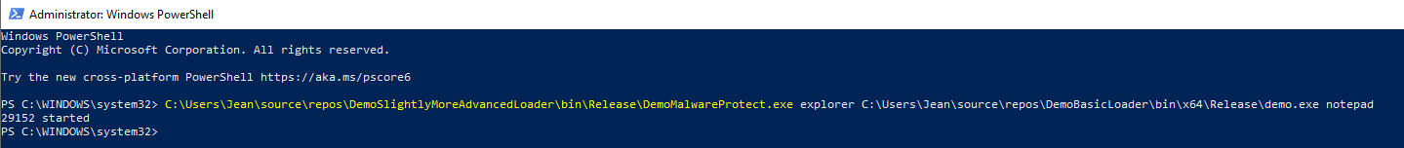
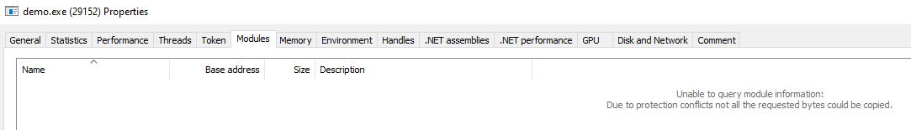
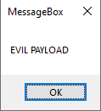
Battle testing our EDR vs our protected demo…

Slide 26
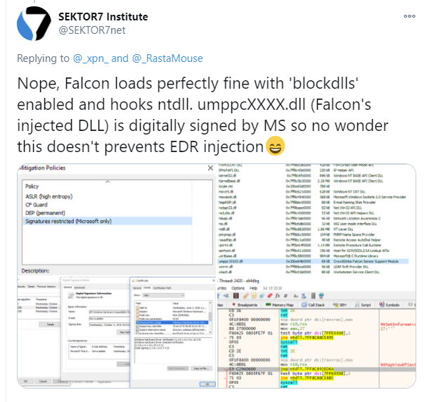
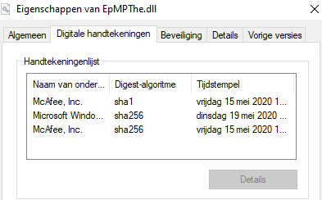
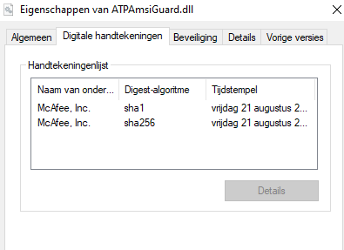
(un)fortunately, vendors caught on to this trick quickly

Slide 27
Disadvantages of P/Invoke
Quoting the wover
.NET provides a mechanism called Platform Invoke
(commonly known as P/Invoke) that allows .NET applications to access data and APIs in unmanaged libraries (DLLs).
By using P/Invoke, a C# developer may easily make calls to the standard Windows APIs.
If you use P/Invoke to call kernel32!CreateRemoteThread then your executable’s IAT will include a static reference to that function, telling everybody that it wants to perform the suspicious behavior of injecting code into a different process.
If the endpoint security product running on the target machine is monitoring API calls (such as via API Hooking), then any calls made via P/Invoke may be detected by the product.

Slide 28
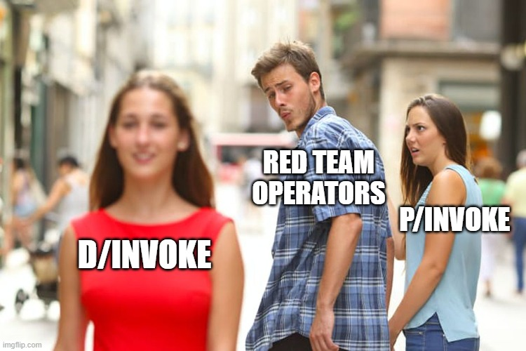
Why use D/Invoke
API imports get resolved dynamically
Functionality to evade hooks using manual mapping, deception and syscalls.
Has function prototypes for a lot of the API calls common offensive tradecraft uses, and we are lazy ☺

Slide 29

D/Invoke Primer
Nuget package (flagged by defender) or source code downloadable on GitHub
Has a built-in injection API for process injection
Capable of resolving API calls in 3 ways:
Standard – much like P/Invoke
Manual Mapping
Overload Mapping
Has a built-in injection API for process injection

Slide 30

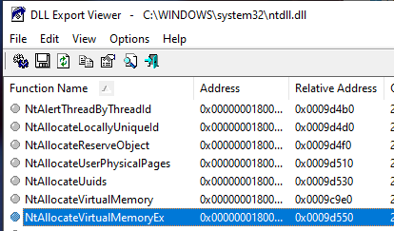
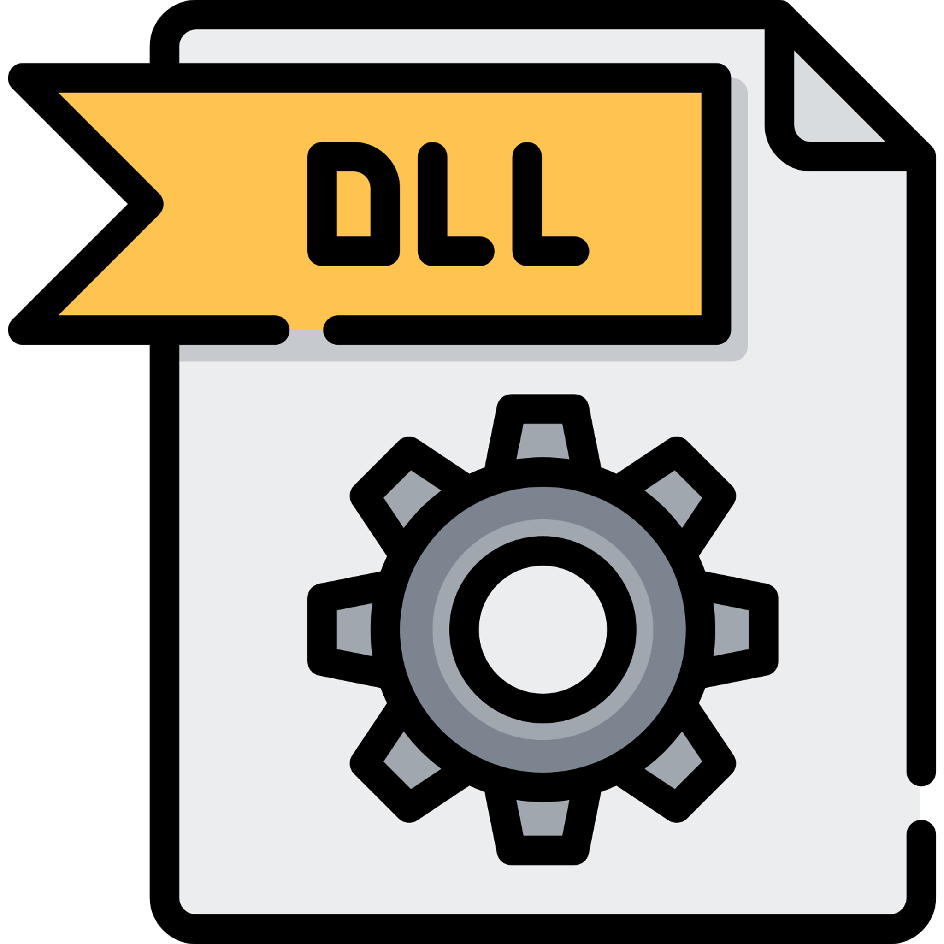


Manual Mapping
Virtual Address Space
NTDLL.dll loaded in Virtual Address Space of a program. The EDR has, however, implemented hooks for key functions.
As we already explained, when an EDR is present, it will typically hook certain functions in the loaded DLLs
(in the example here NtAllocateVirtualMemoryEx from NTDLL.dll).
Anything that now calls that specific hooked function will get inspected by the EDR,
which will then decide whether to allow the function call or to block it and raise an alert.

Slide 31

Manual Mapping
Virtual Address Space
Manual mapping will map a “fresh” dll into memory, which will not be hooked by the EDR as EDR hooks get applied at application-launch. The malware will then execute the needed functions from the freshly mapped dll instead of the normal one, evading the EDR

Slide 32
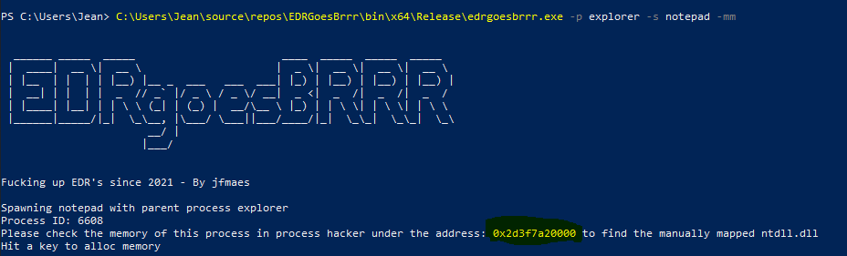
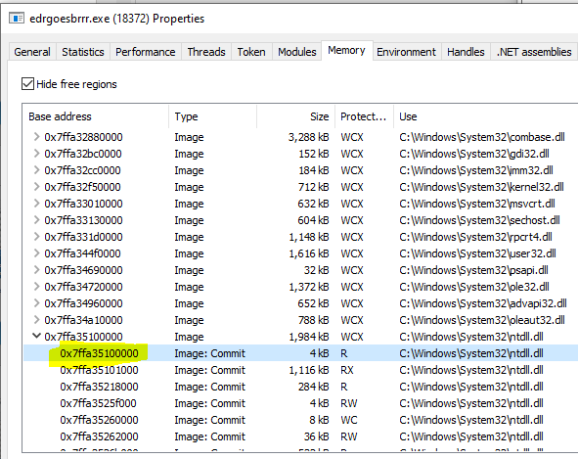
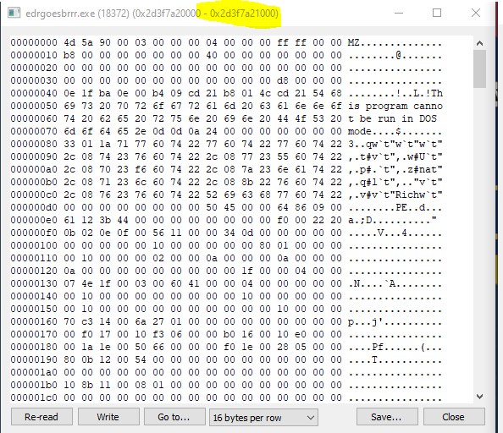
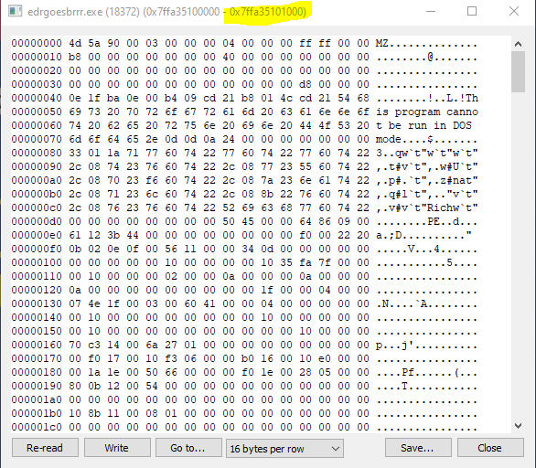
Manual Mapping
Can you tell the difference? No? Neither can the program ¯\_(ツ)_/¯

Slide 33
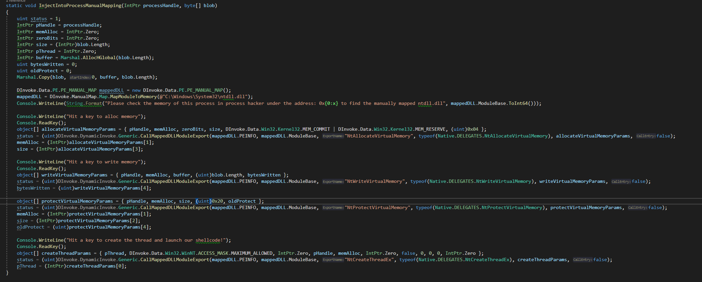
Creating an EDR defeating loader with D/Invoke!
Manual Map

Slide 34
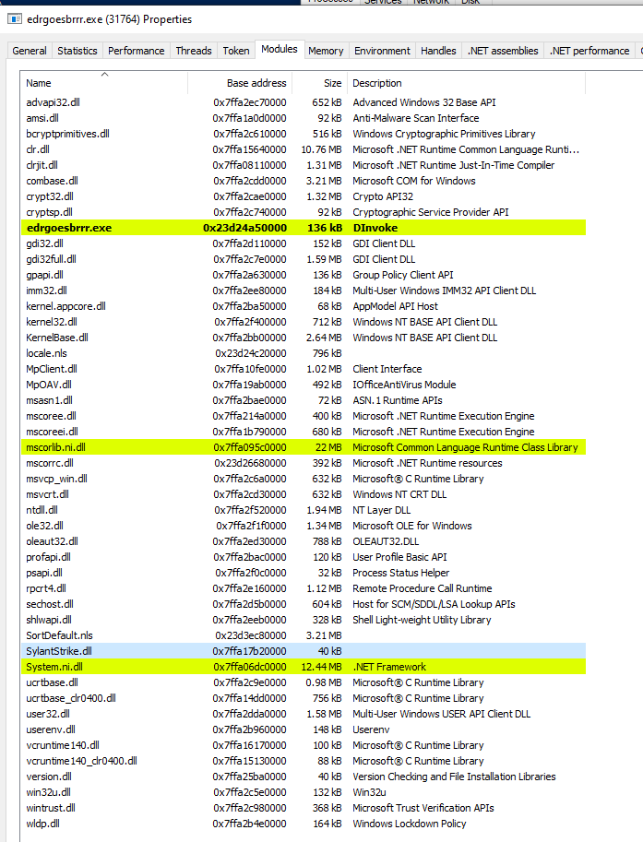
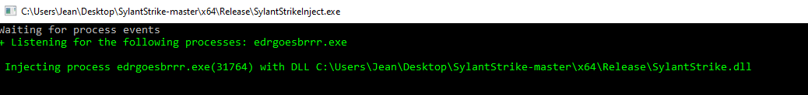
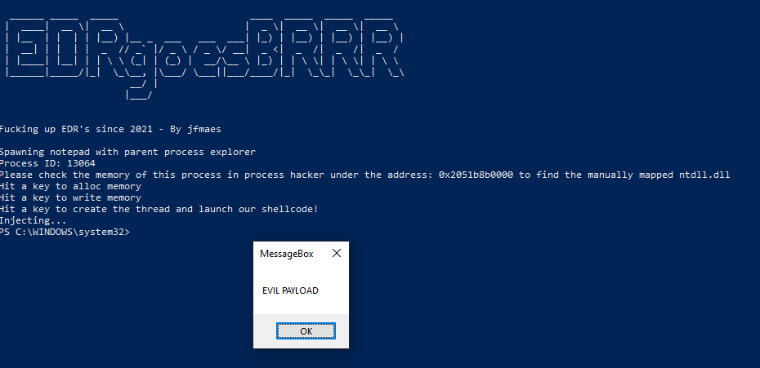
EDR vs D/Invoke Manual Map

Slide 35
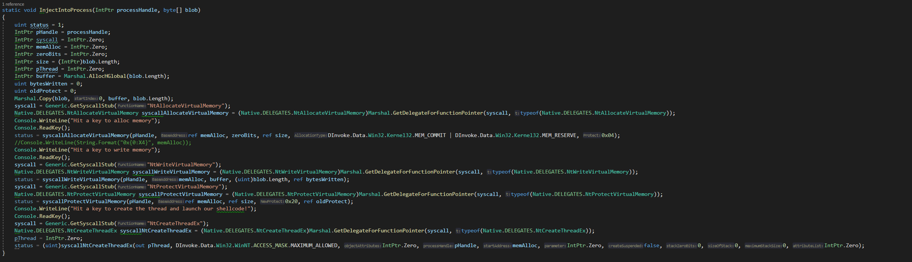
Creating an EDR defeating loader with D/Invoke!
Syscalls

Slide 36
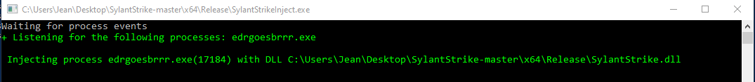
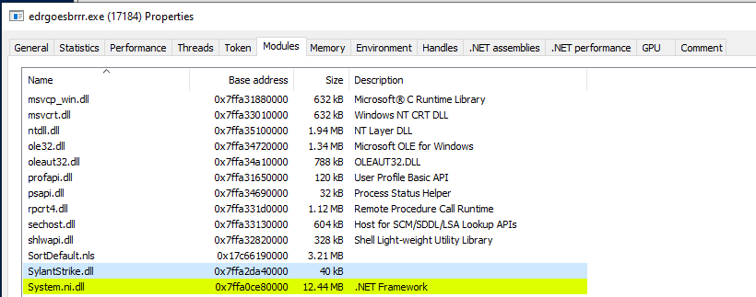

EDR vs D/Invoke Syscalls

Slide 37

Closing notes
D/Invoke needs your help!
Submit PR’s with new Delegates so we can port the entire win32 API to D/invoke!

